Slide 1

Project 5

Slide 2
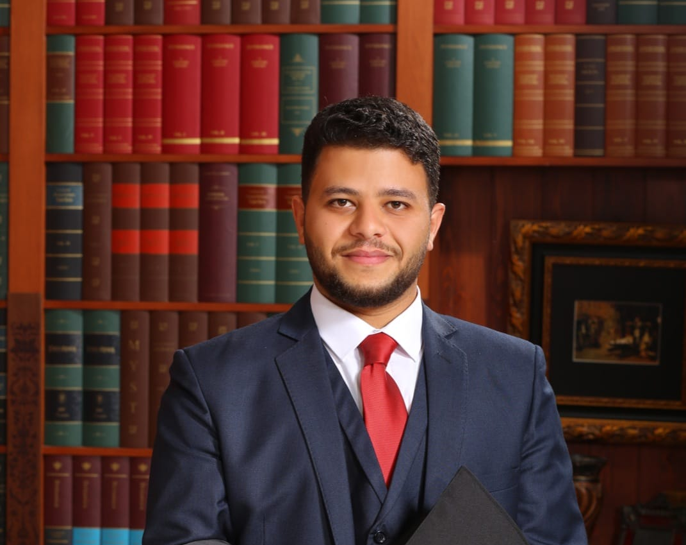
Haitham Al-Ulaimi
Role:scrum

Slide 3
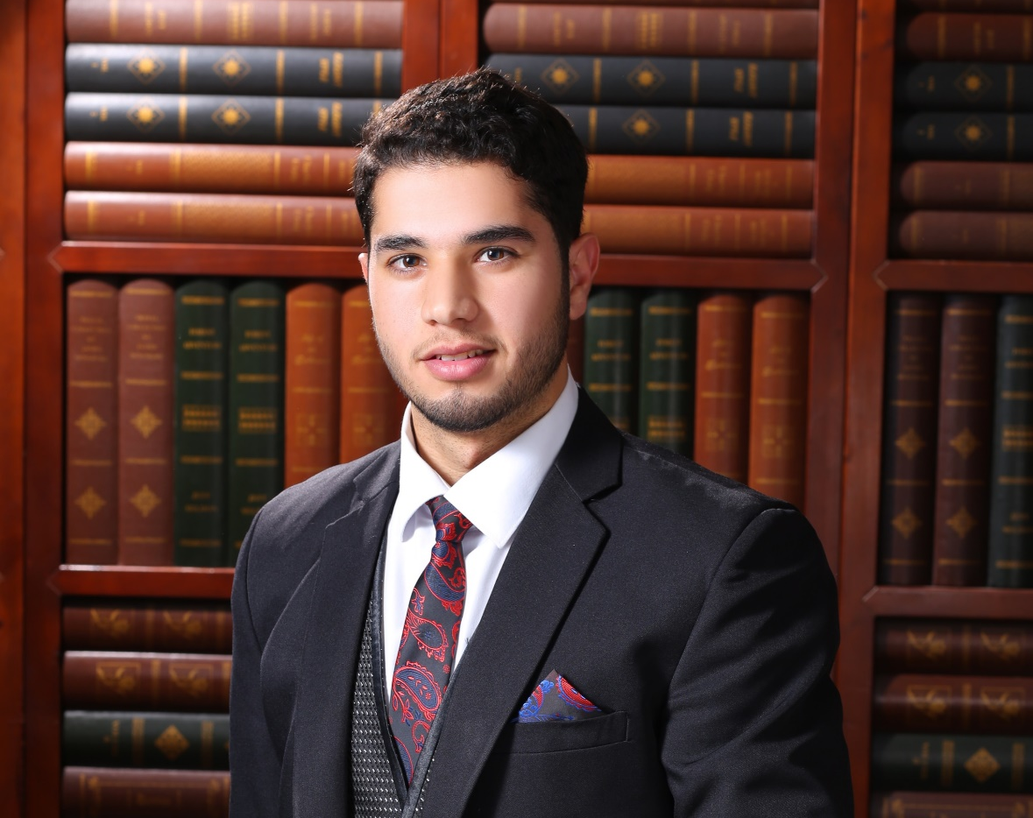
OMAR KATA’A
Role:MEMBER

Slide 4
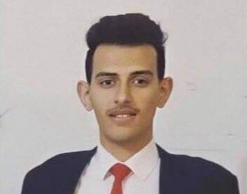
iyad saadeh
Role:MEMBER

Slide 5


Slide 6

SHEFAA
Book Appointment
Join as A Doctor.
contact with a Doctor
Feedback.
Filter& Search.
Calling an Emergency
Attractive dashboard
Doctor Information
Doctors Review

Slide 7


Demo

Slide 8
How we did it ?
Trello
1
sketch
2
Diagram
3
Start
4

Slide 9


What went well ?
Build The backend .

Slide 10
The End

